Slide 1


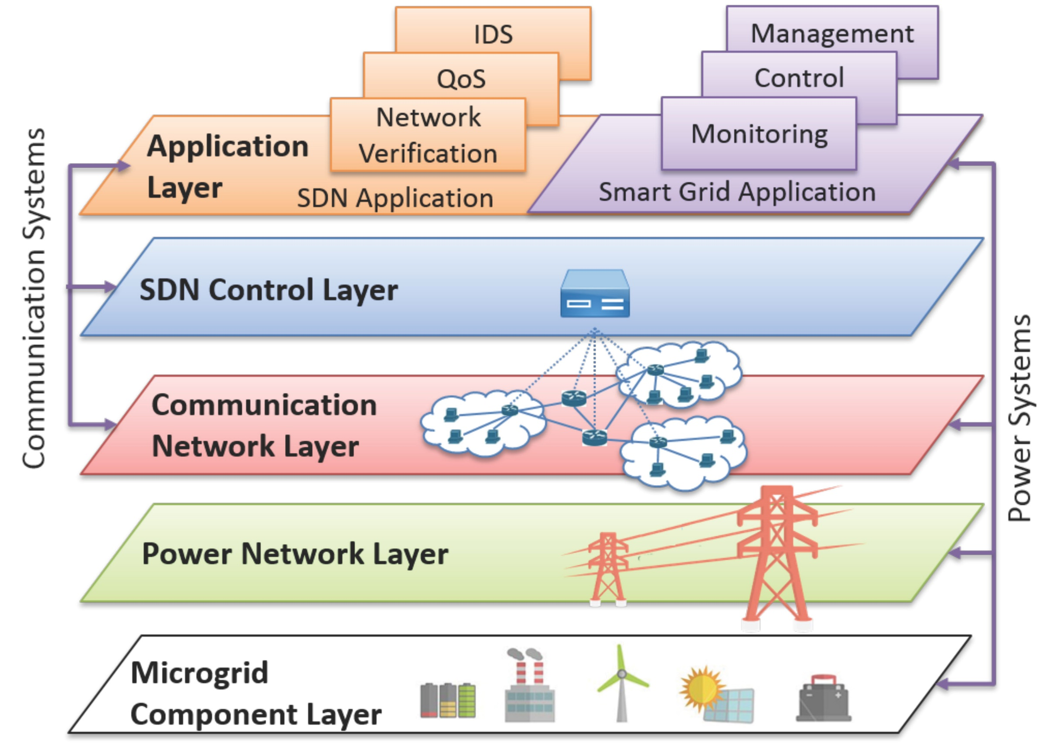
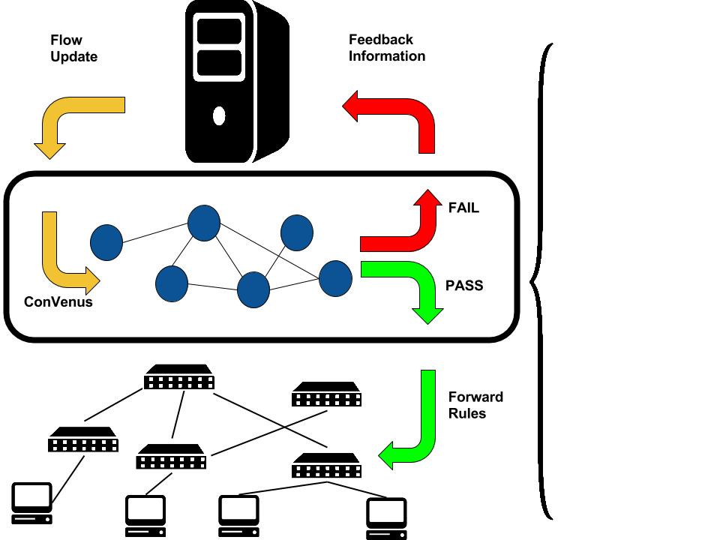
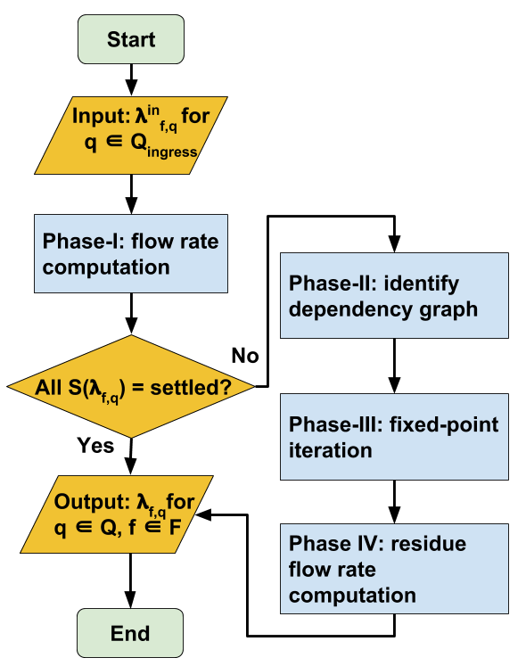
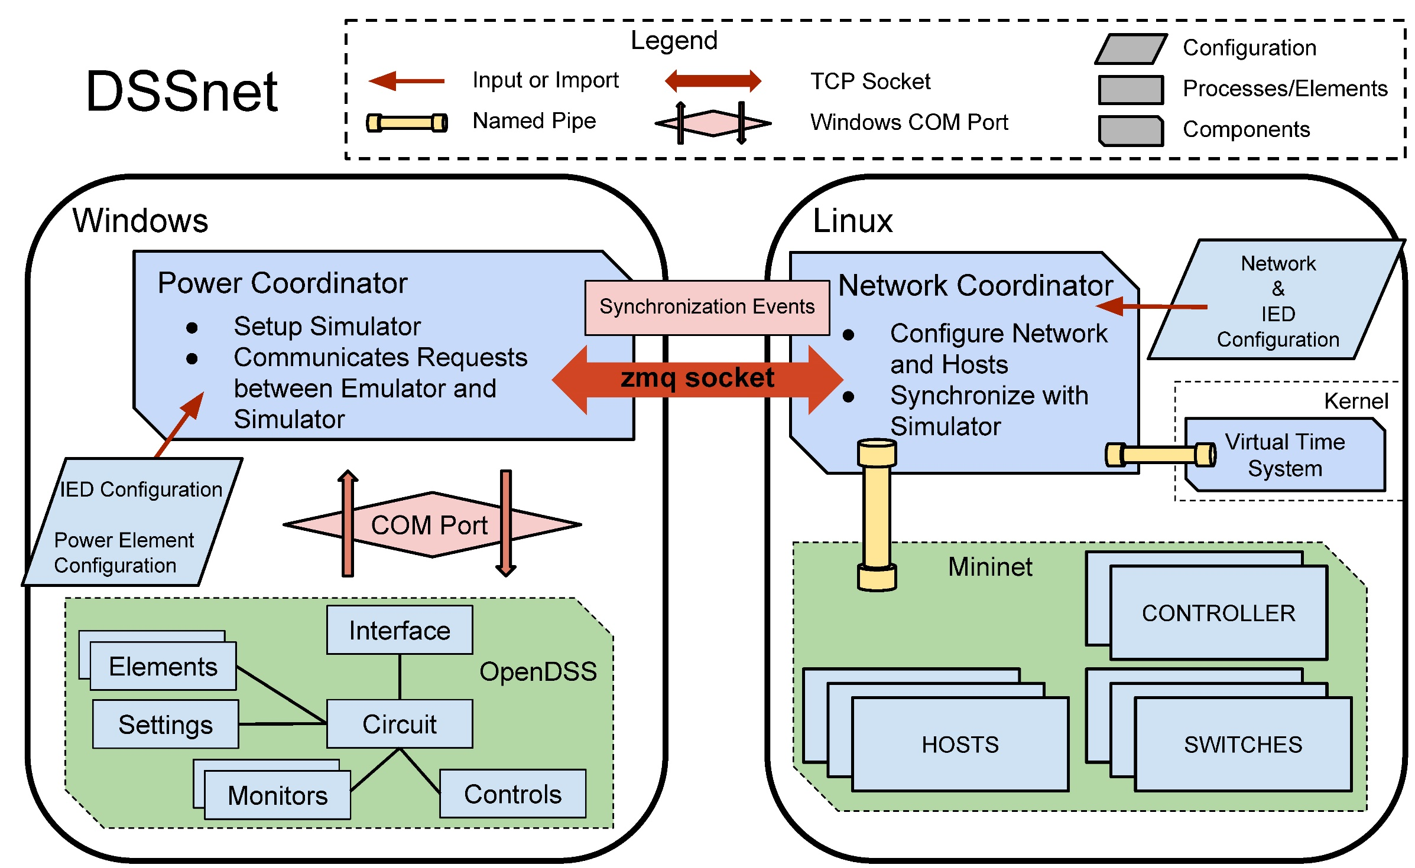
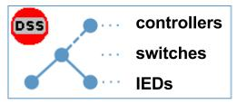
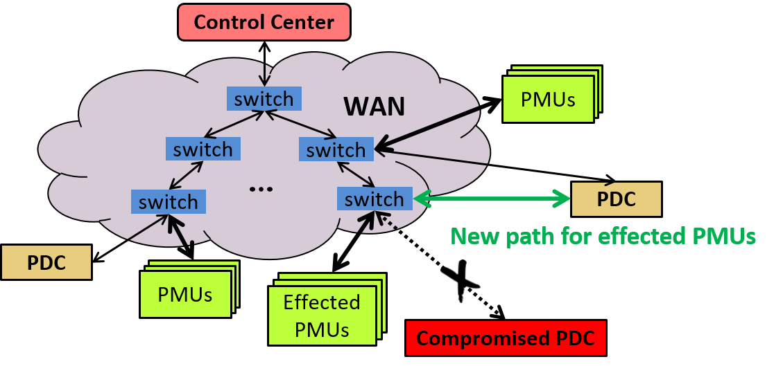

Towards a Secure and Resilient Industrial Control System with Software-Defined Networking
Jiaqi Yan, Xin Liu, Christopher Hannon,
Dong (Kevin) Jin, Cheol Won Lee
Decouples and logically centralizes the control functionality from the data forwarding functionality in an ICS communication network.
Within the SDN-enabled smart grid, we install ConVenus between the control plane and the data plane to enforce the correct network-layer invariants. On the data plane layer, we enhance the resilience of PMU networks against cyber attacks with SelfHealer. We build a hybrid testing platform DSSnet to support high-fidelity analysis of cyber-attacks on SDN-enabled ICSes.
Modern Industrial Control Systems (ICSes) increasingly rely on the computer and communication networks to efficiently monitor and control critical physical processes. Compromising those networks can impact the successful operations of the critical infrastructures, including power grids, oil and gas distribution systems, waster water treatment, etc. In this work, we apply the emerging SDN technology to secure ICSes in the context of smart grids, and investigate several innovative SDN-aware security applications.
SDN Approach
Motivation
Verifies every incoming flow update rules from control plane to forwarding plane in real time
Preserves the congestion-free property in time- and mission- critical ICS networks
ConVenus
Combines electric power distribution system simulation with SDN network emulation
An unique platform for testing and evaluating the SDN-aware applications for ICS resilience and security
Adopts a virtual-time-system-based synchronization method
DSSnet
Directly programs SDN switches s.t. PMUs are isolated from compromised PDCs
Disconnected yet uncompromised PMUs will automatically reconnect to the network
Power system observability is restored with minimal overhead of self-healing process
SelfHealer

